Slide 1
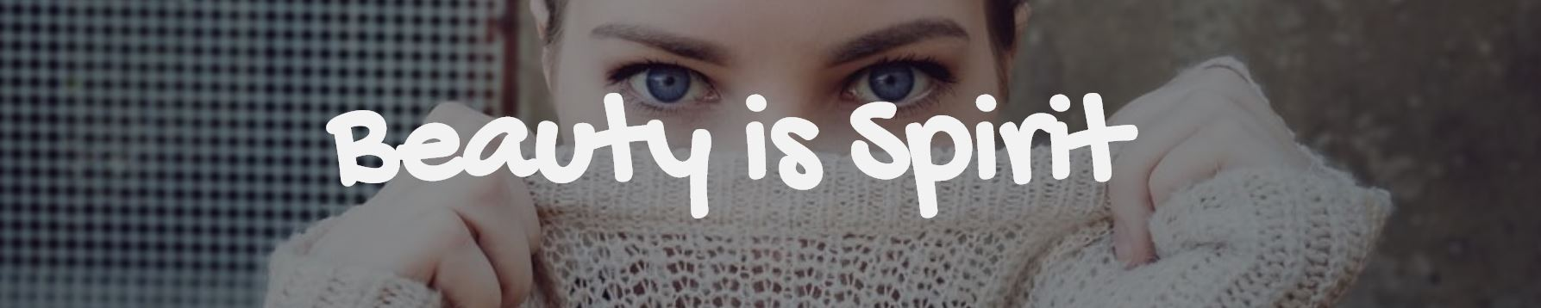
Aussie Beauty Market
ELLIE CHEN
Coder Academy – 11/11/2019

Slide 2
Problems
Two-sided second-hand makeup marketplace
Find products suit you the best: skin type & preferred makeup styles
Existing websites: Gumtree, Facebook Groups, Glambot
Notes:
classified advertisement websites
Online forums on social medias
Glambot

Slide 3
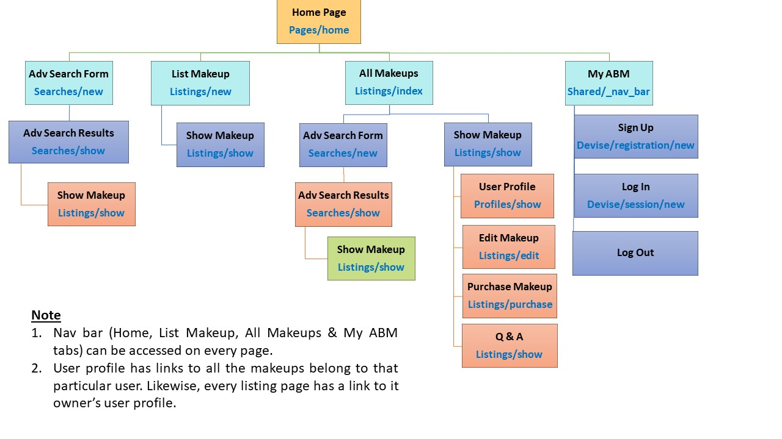

Slide 4
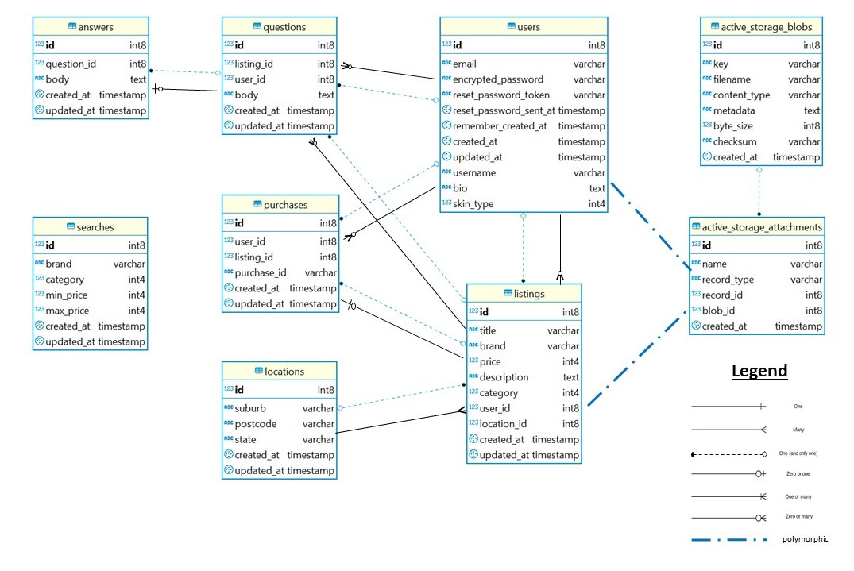

Slide 5
Features
Responsive Web Design
User Authentication & Authorisation
Q & A Section
Dynamic Relationship between User Profile and Show Listing
Searching Capabilities
Notes:
RWD: flexbox + media breakpoints of 600px and 900px)
User Authentication (devise) & Authorisation (before action in controller + if statements in views)

Slide 6
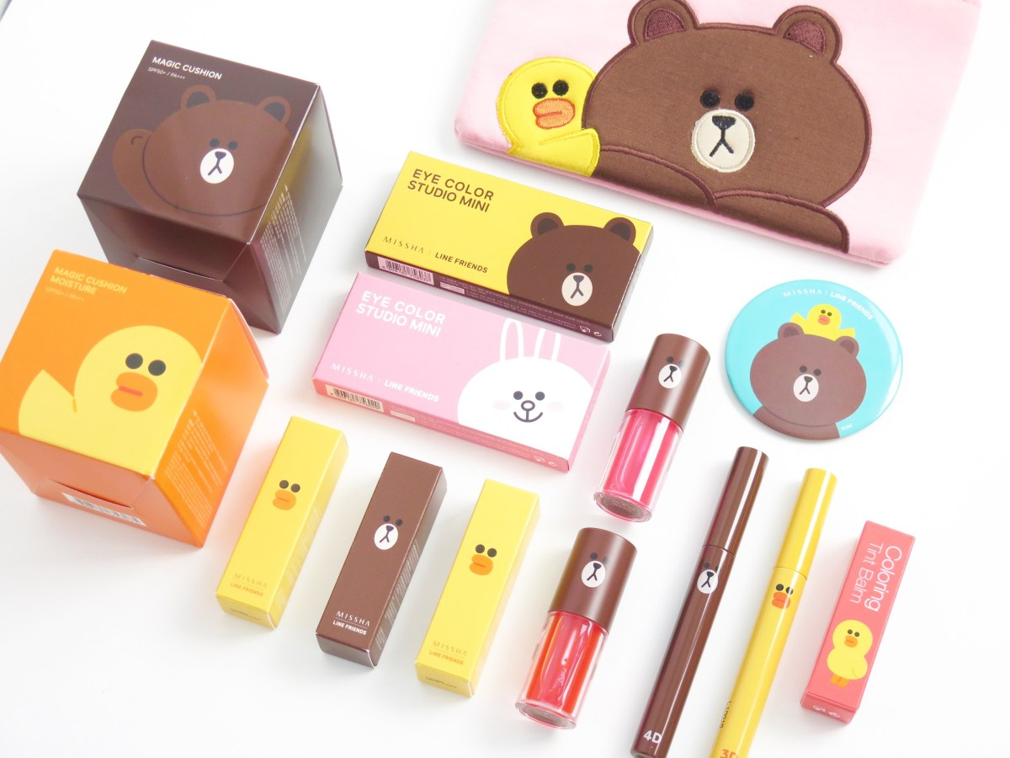
Website Demo
Source: https://dep365.com/wp-content/uploads/2019/07/IMG_0013.jpg

Slide 7
Reflection
What I enjoy most?
What I struggle most with?
What I would do differently next time?
Notes:
Enjoy
Building a huge projects
Received lots of help and support from fellow devs
Struggle
CSS
Next time
Do some more testings

Slide 8

Questions? *^0^*

